Slide 1


The Google File System
Large-scale Data Processing Workloads on Commodity Hardware
By Timothy Chuang

Slide 2
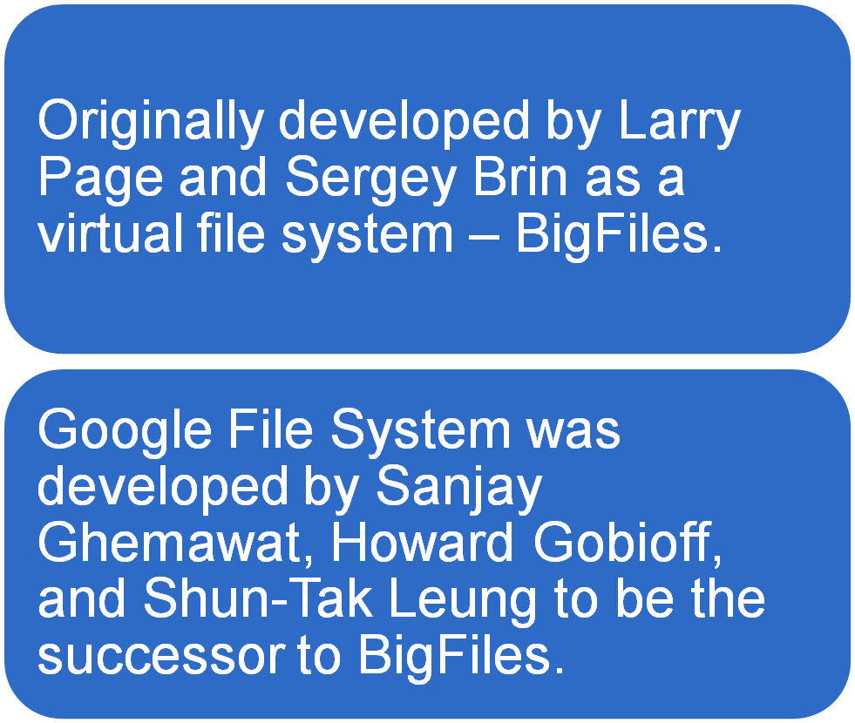
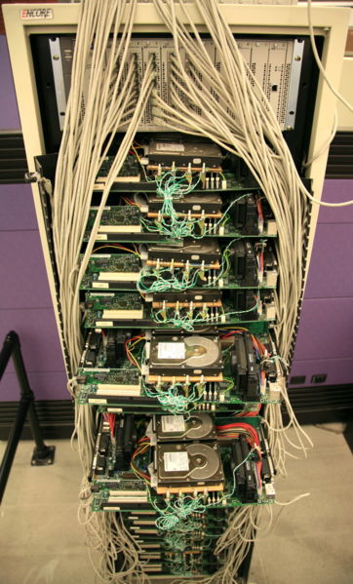
Introduction
Notes:
Bigfiles treated the hard drives on multiple computers as one big pool of storage. Rather than save a file to a particular computer, they would save it to BigFiles, which in turn would locate an available chunk of disk space on one of the computers in the server cluster and give the file to that computer to store, while keeping track of which files were stored on which computer.

Slide 3
Design Assumptions
Built from many inexpensive commodity hardware that often fail.
Store a modest number of large files.
Support two kinds of reads – large streaming and small random reads.
Support large, sequential writes that append data to files.
Support for multiple clients that concurrently append to the same file.
Notes:
The design of GFS is guided by these assumptions that offer both challenges and opportunities.
The system must constantly monitor itself and detect, tolerate, and recover from component failures.
Each file is typically 100 megabytes or more and multi-GB files are common.
In large streaming reads, individual opertaions typically read 1mb or more and operations from the same client often read thru a contiguous region of a file. A small random read usually reads a few KB at an arbitrary offset.
Once the data is written, files are seldom modified again. Small writes at arbitrary position in a file are supported but they do not have to be efficient.
Atomicity and minimal syncronization overhead is important.

Slide 4
Architecture
Single Master, multiple chunkservers.
Fixed chunk size of 64 MB.
Periodic communication between master and chunkservers with “HeartBeat” messages.
No file caching.
Notes:
Master is in charge of all file system metadata ( data about data ). This includes the namespace, access control information, the mpaping from files to chunks, and the current locations of chunks, and other systemwide activities.
Each chunk is identified by a globally unique 64 bit chunk handle assigned by the master at chunk creation.
HeartBeat message is used to determine chunkservers’ states and to give instructions.
Caches offer little benefit in GFS as most applications stream thru huge files or have working set too large to be cached. Not having caches also simplies system design by eliminating cache coherence issues.

Slide 5
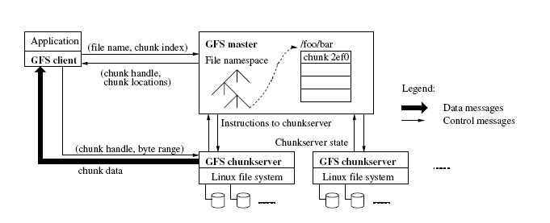
Simple Read Interactions
Notes:
This diagram shows the interactions for a simple read.
Client first translates the file name and byte offset specified by the application into a chunk index within the file, then it sends the request to the master.
Master respondes with the corresponding chunk handle and locations of the replicas. The client caches this information using the file name and chunk index as the key.
Client then sends a request to one of the replicas, usually the closest one. The request specifies the chunk handle and a byte range within that chunk. Further reads of the same file requires no more client-master interaction until the cached information expires or the file is reopened.
This minimizes master’s involvement and reduces the likelyhood of it becoming a bottleneck.

Slide 6
Why Such a Large Chunk Size?
Advantages:
Reduce clients’ need to interact with the master.
Reduce network overhead by keeping a persistent connection to the chunkserver.
Reduce the size of metadata stored on the master.
Notes:
There are several reasons behind choosing such a large chunk size
1. Read and write on the same chunk requires only one initial request to the master for chunk location information. Thereafter, clients can directly communicate with the chunkserver.
2. Since on a large chunk, the client is likely to perform many operations on the same chunk, it can reduce network overhead by keeping a persistent TCP connection to the chunkserver over an extended period of time.
3. It can reduce the size of the metadata stored on the master. This allows GFS to keep the metadata in memory which increases efficiency and speed up master’s operations.
This also allows the master to easily perform periodic scan of its entire state in the background. This scan is used to implement chunk garbage collection, re-replication in case of chunkserver failure and chunk migration for load-balancing.

Slide 7
Disadvantages:
Serious internal fragmentation when storing small files.
Chunkservers that contain many small files may become hot spots.
Notes:
One of the obvious disadvantages of having such big block size is the internal fragmentation. Internal fragmentation means a lot of wasted space when storing small files.
This could result in overload of chunkservers due to hundreds of simultaneous requests.

Slide 8
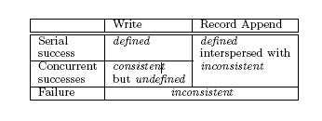
Guarantees by GFS
Relaxed consistency model
Atomic file namespace mutation with namespace locking.
Atomic Record Append.
Notes:
Relaxed consistency model is good enough to support Google’s highly distributed but remains relatively easy and efficient to implement.
Filename space (things like file creation) mutations are handled only by the master and namespace locking guarantees atomicity and correctness.
GFS provides an atomic append operation called Record Append. GFS apends the data specified by the client to the file at least once atomically, as one continuous sequence of bytes.
This table summerizes the results of two different writes. A file region is consistent if all clients will always see the same data, regardless of which replicas they read from. A region is defined after a file mutation if it is consistent and clients will see the mutation writes in its entirety. When a mutation succeeds without interference from concurrent writers, the affected region is defined. Concurrent successful mutations leave the region undefined but consistent, but it may not reflect what any one mutation has written. Failed mutation always leaves the region inconsistent, and clients will issue retries if the region is undefined.

Slide 9
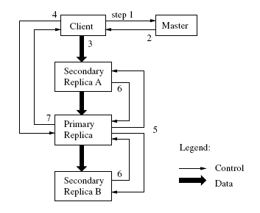
Leases and Mutation order
Notes:
Since each file mutation is performed at all the chunks replicas, GFS uses leases to maintain a consistent mutation order across replicas.
The master grants a chunk lease to one of the replicas, which is called the Primary. The primary picks a serial order for all mutations to the chunk. All replicas will follow the same order.
The lease mechanism is designed to minimize management overhead at the master. A lease is typically 60 seconds long, but typically, a chunk can receive extensions from the master indefinitely.
This chart illustrates the process by following the control flow of a write thru these numbered steps.
The client asks the master which chunkserver holds the current lease for the chunk and the locations of the other replicas. If no one has a lease, the master grants one to a replica it chooses.
The master replies with the identity of the primary. The client caches this data for future mutations. It only needs to contact the master again if the primary becomes unreachable or replies that it no longer holds the lease.
The client pushes data to all replicas. This can be done in any order. By decoupling the data flow from control flow, GFS can improve performance by scheduling the expensive dataflow based on network layout regardless of which server is the primary. The data is stored in the buffer.
Once all the replicas have acknowledged receiving the data, the client sends a write request to the primary, the primary assigns consecutive serial numbers to all the mutations it receives.
The primary forwards the write requests to all of its replicas. Each replica applies mutations in the same order.
The secondary replicas all reply to the primary indicating that they have completed the operation.
The primary replies to the client. Any error encountered at any of the replicas are also reported. If not all of the replicas have succeeded in applying the mutation, this request is considered to have failed, and client will retry the failed mutation. It’ll make a few attempts at stop 3 thru 7 before restarting from the beginning.

Slide 10
Fault-tolerance
Fast Recovery
Master and chunkservers are designed to restore their state and start in seconds.
Chunk Replication
Each chunk is replicated on mutiple chunkservers on different racks.
Master Replication
The master state is replicated for reliability.
Notes:
Since the quality and quantity of components cannot be trusted, GFS has implemented several fault-tolerance measures to guard against data loss.
Fast recovery:
Both master and chunkservers are designed to restore their state and start in seconds.
Chunk Replication:
The master clones existing replicas as needed to keep each chunk fully replicated as chunkservers go offline or detect corrupted replicas thru checksum verification.
Master Replication:
Master keeps an operation log and such log is replicated on mupltiple machines. It also check points periodically and such information is also replicated on multiple machines.
In the event of a master failure, monitoring infrastucture outside GFS starts a new master process elsewhere with the replicated operation log and load the latest checkpoint. Clients only need to know the alias of the master because it’s a DNS name that can be changed if the master is relocated.

Slide 11
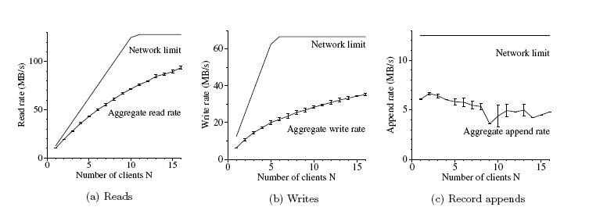
Performance
Measurements
Notes:
These 3 charts show the aggregate throughputs of different operations for 1 master, 16 readers and 16 writers. Top curves show theoretical limits imposed by the network. Bottom curves show measured thruputs.
Shows the performance for random reads. The performance goes down as the number of readers increases as the network becomes more saturated.
Shows N clients write simultaneously to N distinct files. Each client writes 1GB of data to a new file in a series of 1 MB writes. Write is much slower because each byte has to be written to all of the chunk’s replicas.
Shows record apend performance. N clients append simultaneously to the same file. Performance is limited by the network bandwidth of the chunkserver, independent of the number of clients. The performance starts to drop slightly as the number of clients increases due to congestion and variances in network transfer rates seen by different clients.

Slide 12
Sources
Ghemawat, Sanjay et al. “The Google File System”
Carr, David F. “How Google Works” http://www.baselinemag.com/c/a/Projects-Networks-and-Storage/How-Google-Works-%5B1%5D/4/
Wikipedia, “Google”
http://en.wikipedia.org/wiki/Google

Slide 13

Questions?

